Slide 1

Prediction of Success for Currently Operating Startups

Slide 2
Authors
Dr. T. Sampath Kumar - t.sampathkumar@sru.edu.in
Anugam Saikiran - saikirananugam@gmail.com
Irukulla Apoorva – irukullaapoorva@gmail.com
Anugam Uday kiran – anugamudaykiran@gmail.com
Meghana Daddanala – meghanadaddanala@gmail.com
Amogh Varsh Raju – varshrajuambati@gmail.com

Slide 3

Problem statement
The goal of this project is to develop a predictive model using machine learning algorithms that can accurately assess the likelihood of success for currently operating startups.
Success in this context is defined as sustainable growth, profitability, and longevity beyond a certain timeframe.

Slide 4

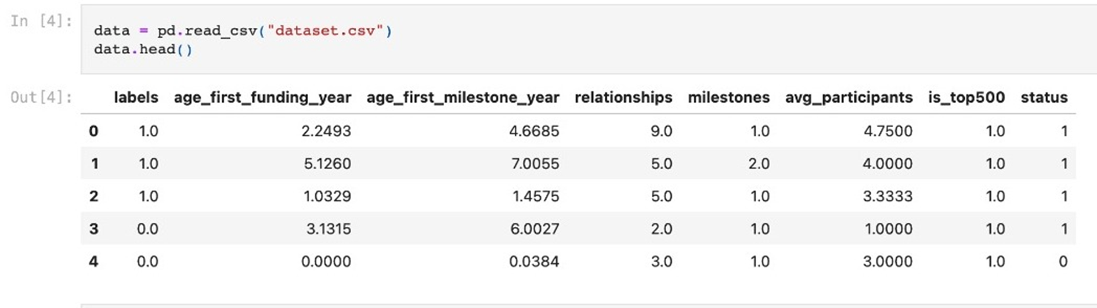
PROPOSED METHODOLOGY DATA SET:

Slide 5
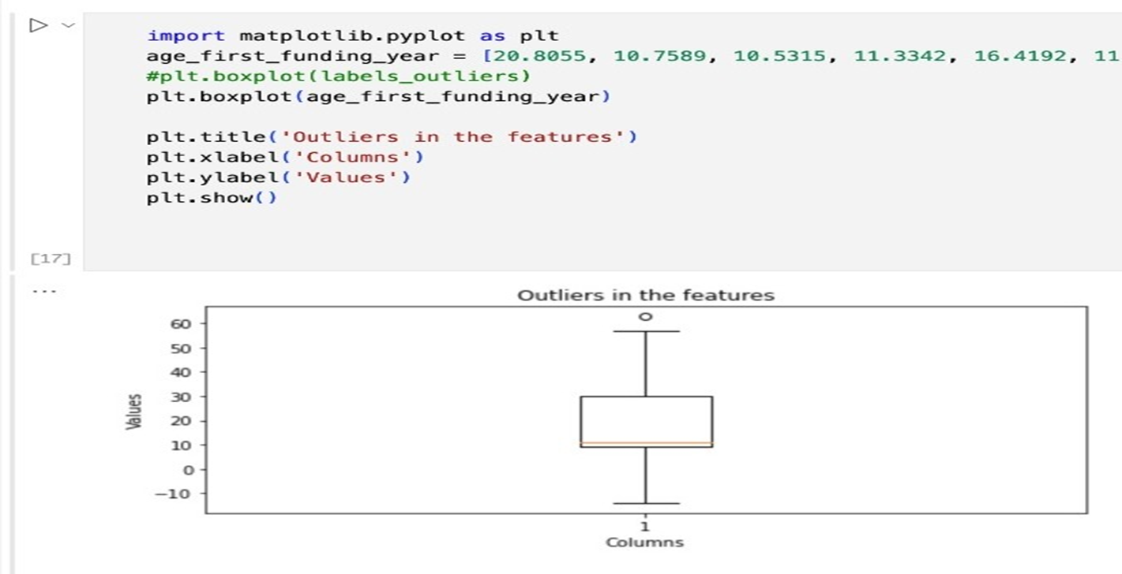

DATA PREPROCESSING: Outline detection:

Slide 6
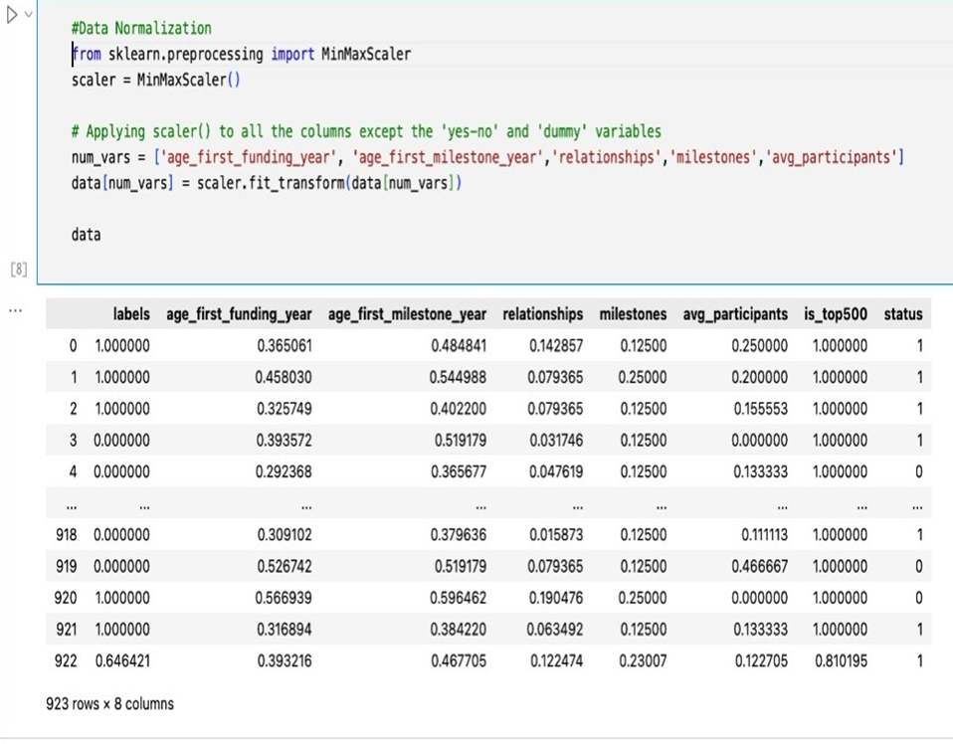
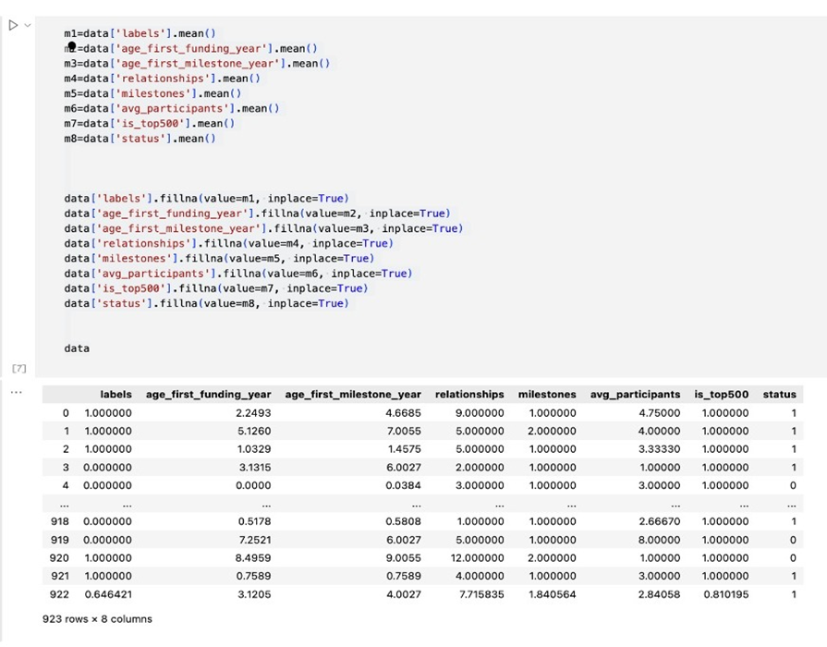
Normalization:
When applying normalization, it's essential to fit the scaler on the training data and then use the same scaler to transform both the training and testing/validation data. This ensures that the normalization is consistent across all data points.

Slide 7
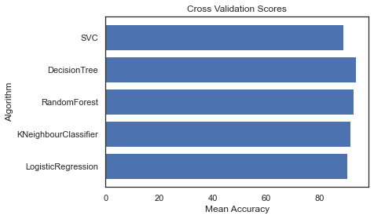
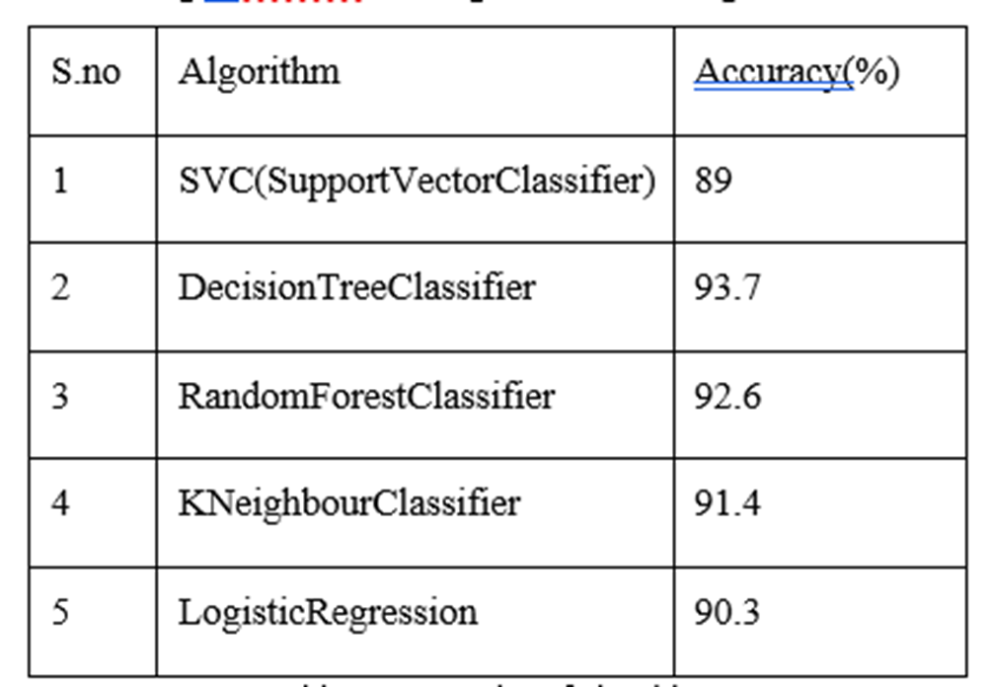
Models used:
The DecisionTreeClassifier model, loaded from the 'model.pkl' file, is then used to predict the success of the startup based on the input data. Here pkl indicates it is a pickle file.

Slide 8
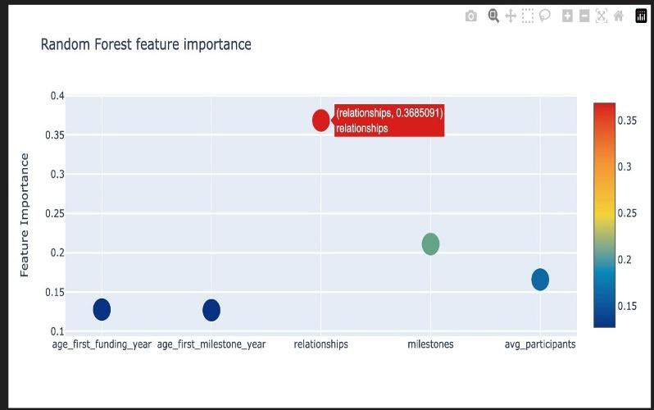
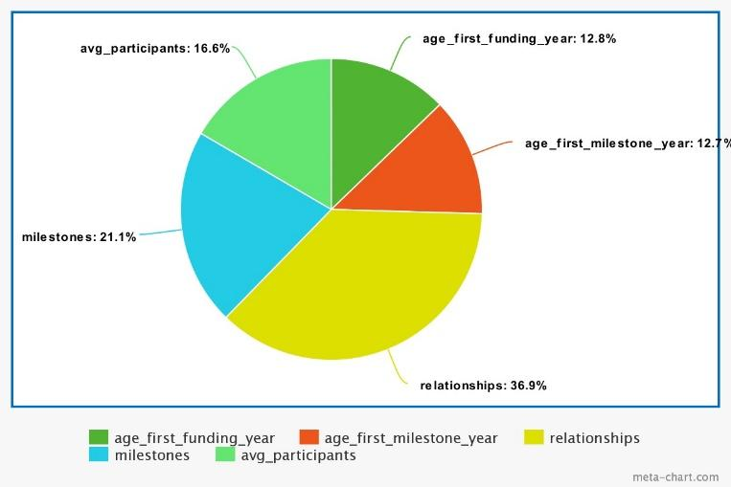
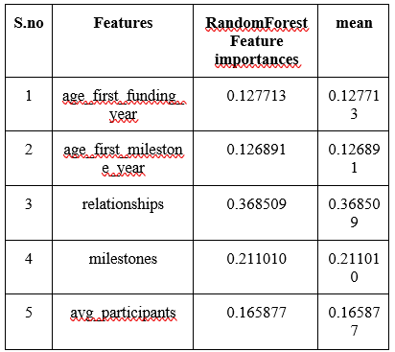
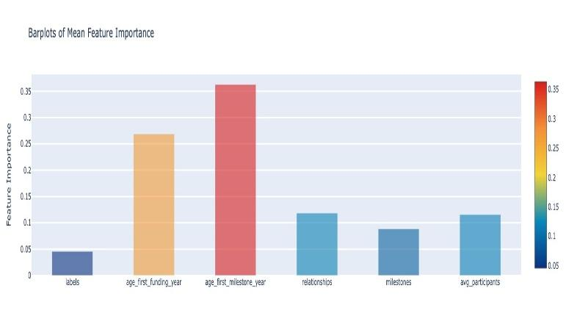
We took feature importance's from the RFC model, saved them in a Data Frame with their names. After filtering out non-zero values, we created scatterplots using a plotting function to visualize these importance's.

Slide 9
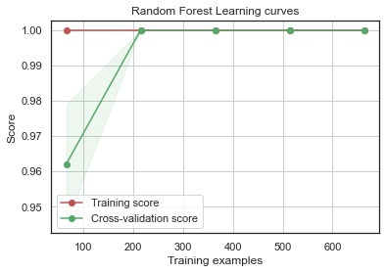
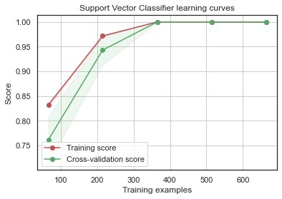
From the above diagram, learning curves reveal the model's behavior, highlighting overfitting or underfitting problems. By studying the gap between training and cross-validation scores, it's possible to assess bias, variance, and data needs. This informs model choices, parameter adjustments, and data collection to enhance performance.

Slide 10
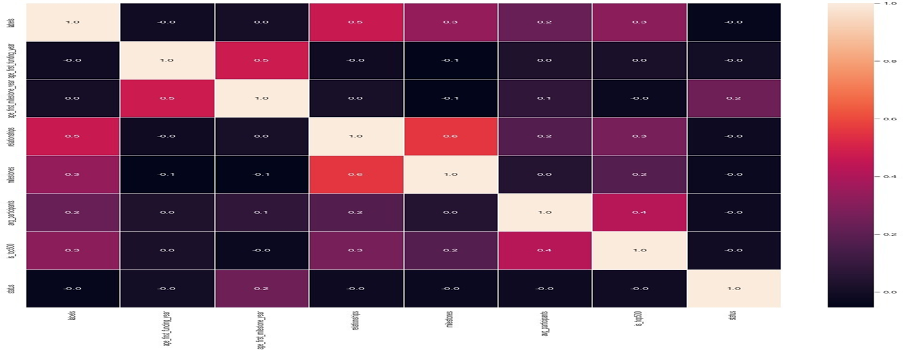
Confusion Matrix:
The above figure displays a confusion matrix created with 'sns.heatmap', utilizing the correlation matrix as input. This visualization illustrates the connections among numerical features in the dataset, offering insights into their relationships.

Slide 11
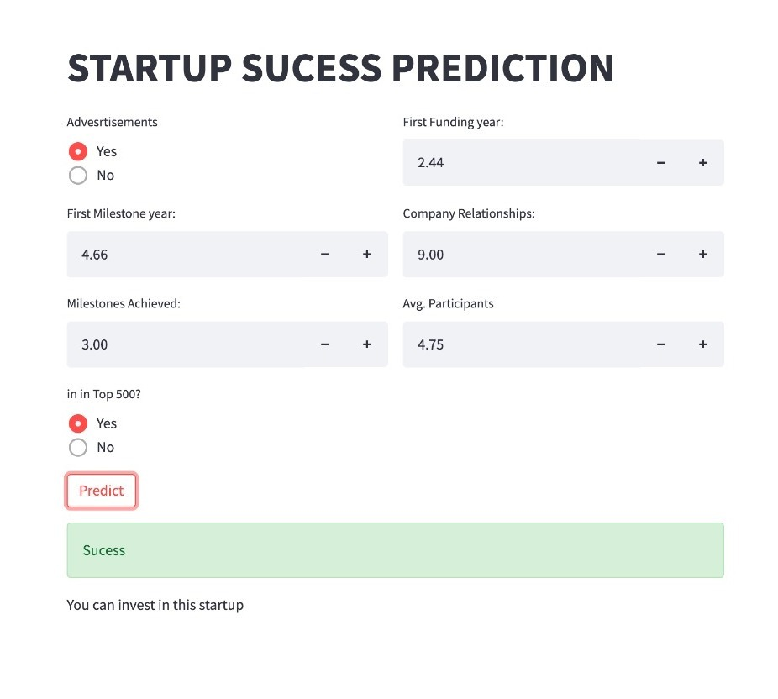
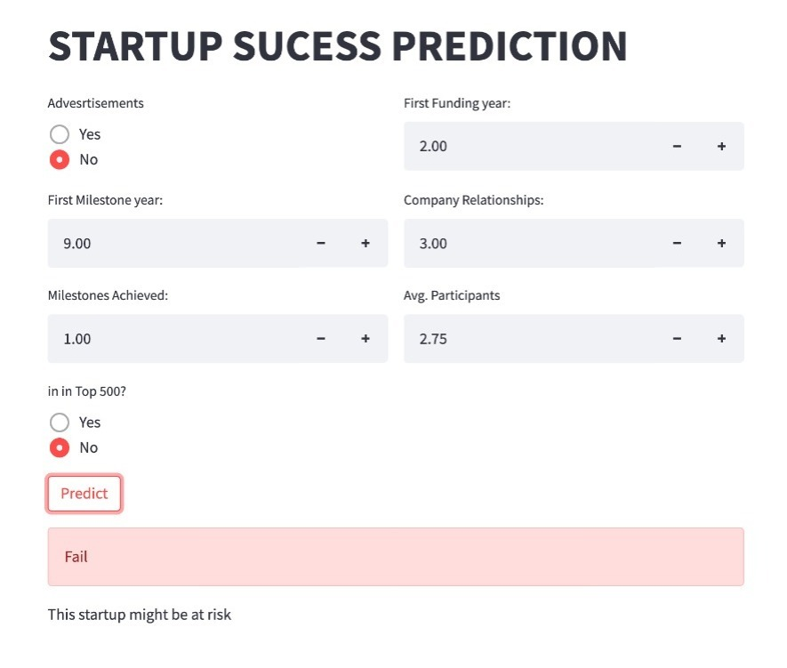
RESULTS:

Slide 12
CONCLUSION
This Research Paper Emphasizes Using Machine Learning To Predict Success In Currently Operating Startups.
Features Like Company Ranking, Relationships, Funding Year, Milestones, Participants, And Advertising Are Integrated For Comprehensive Analysis.
Machine Learning Aids Investors, Stakeholders, And Interested Parties In Making Informed Investment Decisions.
Accurate Predictions Help Investors Allocate Resources Wisely, Reducing Risks And Increasing Returns.
Startup Owners Benefit By Identifying Areas For Improvement And Increasing Success Chances.
Overall, Machine Learning For Startup Prediction Aims Stakeholders In Informed Decision-making, Fostering Startup Growth In A Competitive Business Environment.

Slide 13


Thank You

